Slide 1
Chapter 2 Configuration Space
Chapter 3 Rigid-Body Motions
Chapter 4 Forward Kinematics
Chapter 5 Velocity Kinematics and Statics
Chapter 6 Inverse Kinematics
Chapter 7 Kinematics of Closed Chains
Chapter 8 Dynamics of Open Chains
Chapter 9 Trajectory Generation
Chapter 10 Motion Planning
Chapter 11 Robot Control
Chapter 12 Grasping and Manipulation
Chapter 13 Wheeled Mobile Robots
13.1 Types of Wheeled Mobile Robots
13.2 Omnidirectional Wheeled Mobile Robots
13.3 Nonholonomic Wheeled Mobile Robots
13.4 Odometry

Slide 2
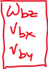
Important concepts, symbols, and equations
Relationship between planar and spatial twist:

Slide 3
Important concepts, symbols, and equations (cont.)
Odometry (or dead reckoning)

Slide 4
Important concepts, symbols, and equations (cont.)
Diff-drive

Slide 5
Important concepts, symbols, and equations (cont.)

Slide 6
Important concepts, symbols, and equations (cont.)

Slide 7
Important concepts, symbols, and equations (cont.)
Could instead use SE(2) representations
and use a matrix exponential for se(2).
or
rotate the
linear
component

Slide 8
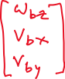
Important concepts, symbols, and equations (cont.)
“Matrix exponential” for se(2) using center of rotation (CoR) visualization
CoR

Slide 9
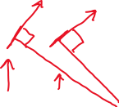
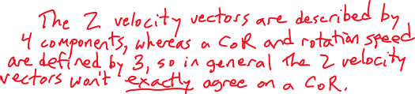
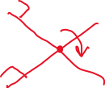
Draw the proper angles of the front wheels
of the car-like mobile robot for the CoR
shown. (Ackermann steering.) How do the
rolling speeds of the rear wheels compare?
rear
wheels
CoR
Your mobile robot is equipped with two mouse
sensors for odometry. They report the velocity
vectors shown. Where is the CoR?

